Slide 1
Magic Mirror
By Darimar Rios, Calvin Grant, Umang Gurung

Slide 2
Description and Goals
Our project is a mirror that shows the time, date, and weather, the purpose was to provide people a convenient way for people to start their day and plan accordingly without having to look at their cellphones.
We accomplished this by using a two-way mirror that has a computer screen in the back in which our GUI is displayed, and a sensor that detects when someone is nearby and turns on the GUI.

Slide 3
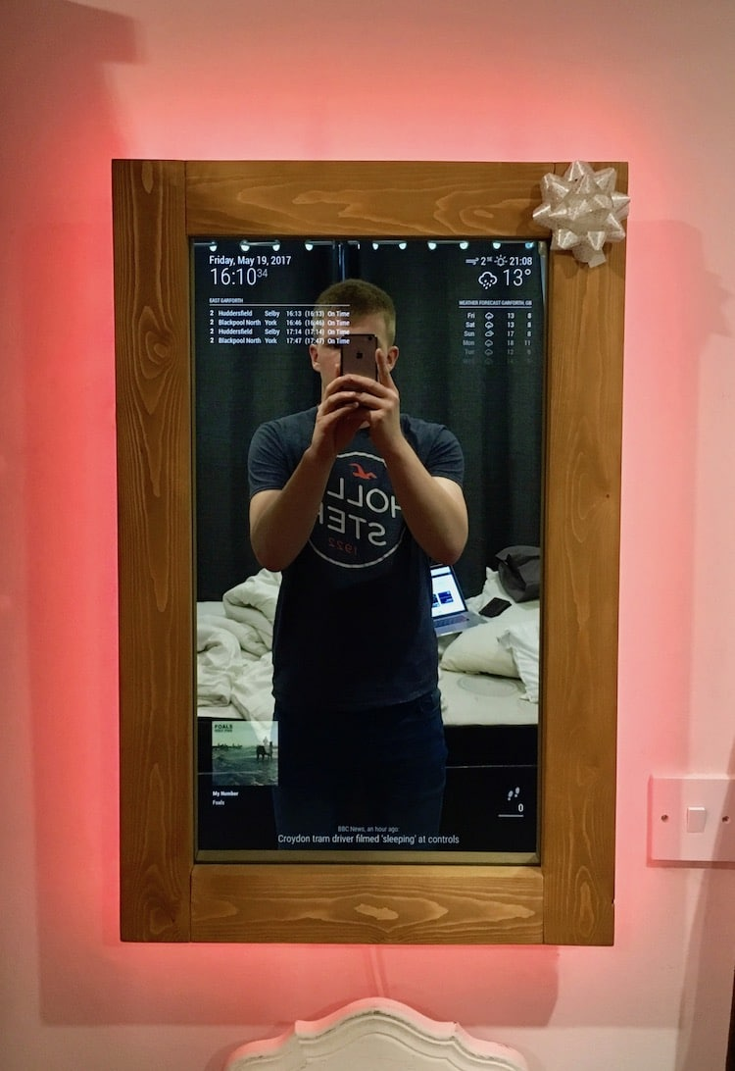
Goals

Slide 4

Initial Design Phase
This was our initial design phase
We planned to use a different screen but later decided to make use of our raspberry pi and not spend money on any screens
We wanted to cover the whole mirror with the screen but that was not possible due to the given reasons.

Slide 5
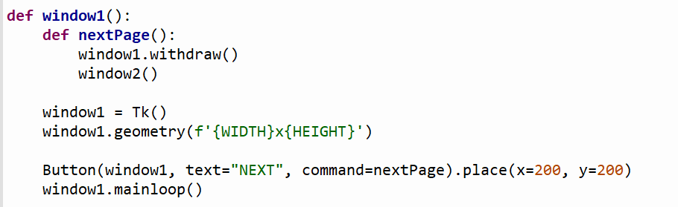
Switching between tkinter Windows (initial)
Initially we thought that they project would entail figuring out a way to switch between Tkinter windows using GPIO pins.
We thought by some how using the withdraw() , which removes a window from the screen without destroying it
Here is the basic GUI example of the code for a withdraw function without GPIO

Slide 6
Using Raspberry Pi GPIO to activate a GUI
Starting the project we had the idea of somehow using the Raspberry pi’s GPIO to access the Magic Mirror’s window display and the various widgets/ API call.
We ran across problems as we tried to implement tkinter button calls from a physical GPIO buttons.
We based our first prototype on the Adaptive Simon game, hoping to use a similar approach to the use of GPIO switches.
With a window being displayed instead of a sound being played.
Using the same While true loop.
To our ability we found it nearly impossible to connect our GPIO pins to their GUI counterparts to turn on the MagicMirror.
Notes:
Insert code here

Slide 7
Using Raspberry Pi GPIO to activate a GUI
We then thought back to CSC 101 and the implementation of the Ultrasonic sort code. Using this sensor could be a more efficient way to activate what would seem like a motion censored Magic Mirror.
With Dr. Gourds help we were able to implement a variation that presented a GUI when a certain distance was reached.
We realized that we would have to instantiate the Window that we were going to present our widgets and API to allow for the ‘motion sensor’ effect.
Notes:
Need more code here

Slide 8
Using Raspberry Pi GPIO to activate a GUI
The ultrasonic sensor still calibrates and uses that distance to run the code. But, instead of returning an object’s distance, it returns the displays GUI.
To have the GUI present the widgets when a person gets close enough we used .pack() and .pack_forget() to allow for the widgets to be seemingly erased from the screen until a distance was reached. Using an if: else: statement.

Slide 9
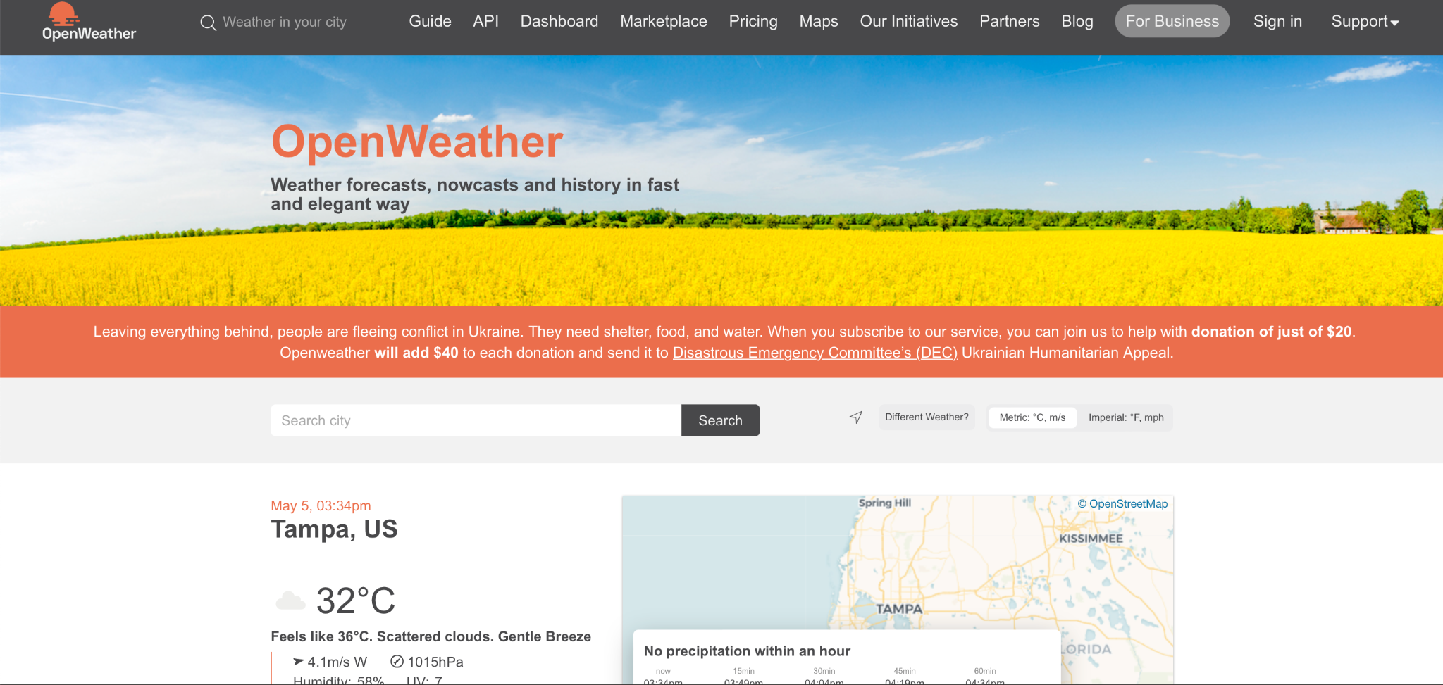
Using the API
API is Application programming interface with a set of functions that allows to access data and interact with the external software.
Most o the apps that have data fetched in real time uses API like most of the Weather apps.
We used openweatherapi for our project

Slide 10
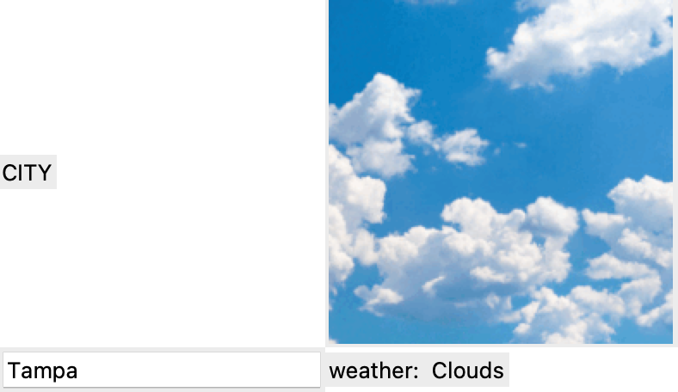
Making the API work
First of all we created an apikey to be used in our code which will be read by the computer and read the api_address .
Basically it will update our screen with real time data every time we fetch it.
You can type in any city name, and it will display what kind of weather there is

Slide 11
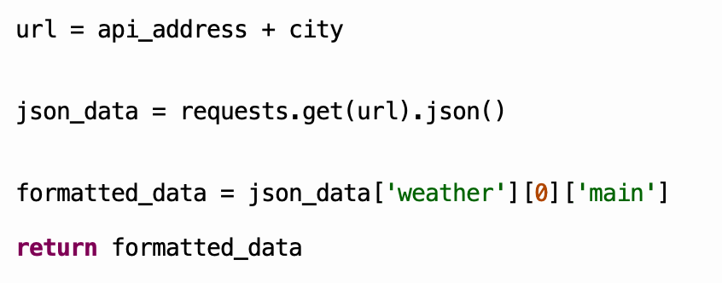
More about API
This is the basic code that we used for the API
The url takes the api_adress and the city name entered
It fetches and requests to get data through the website
The formatted_data shows what kind of data we want, for this we only the took the weather and returned back the data

Slide 12
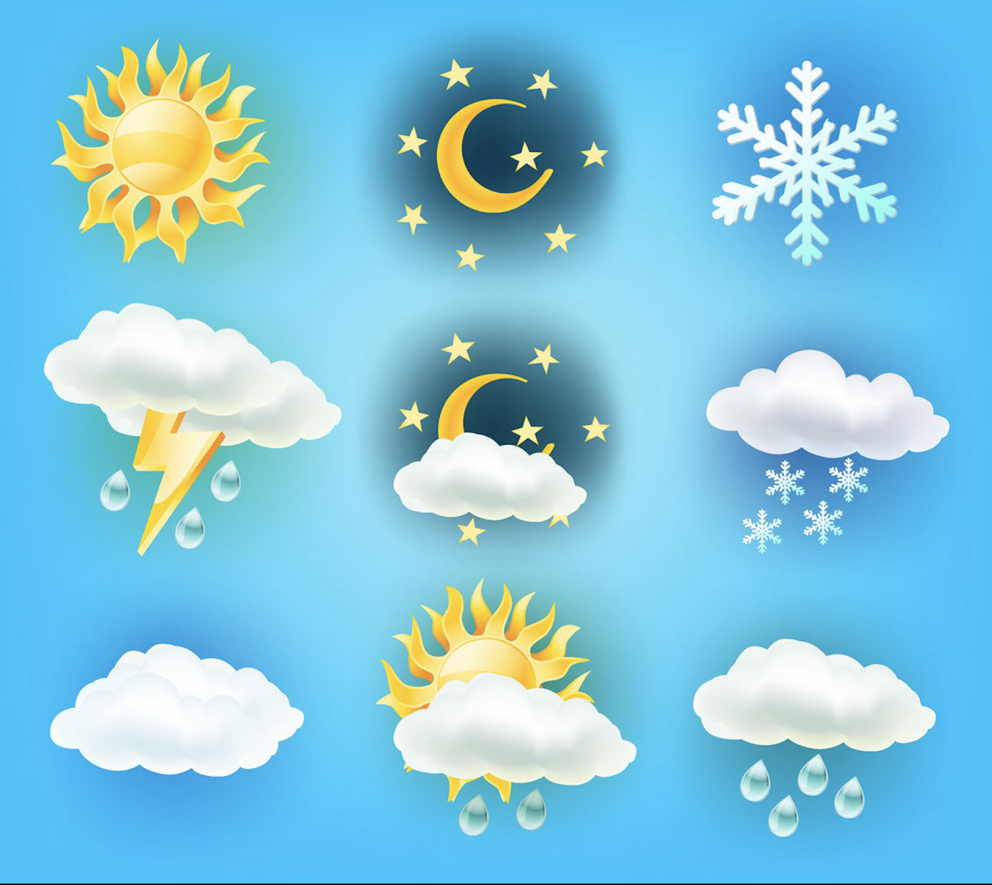
How we displayed pictures
Whenever our code retains a certain weather type, we created a if code to pass a image and show the corresponding image to that weather type
We only have a limited pictures and we were able to have five different pictures, if the weather is something different it shows the same image as before which is one of the drawbacks.

Slide 13
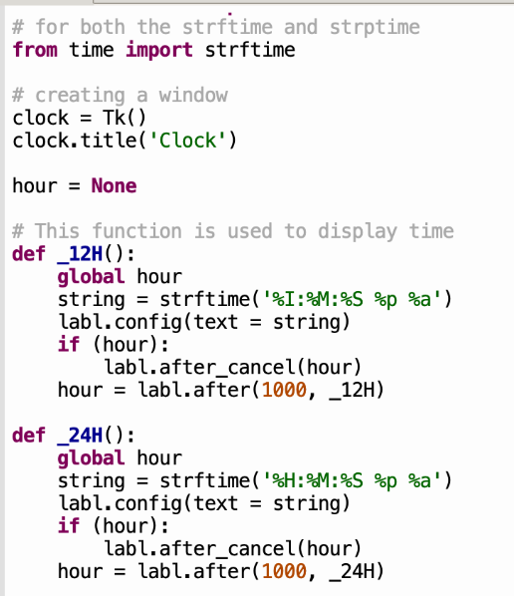
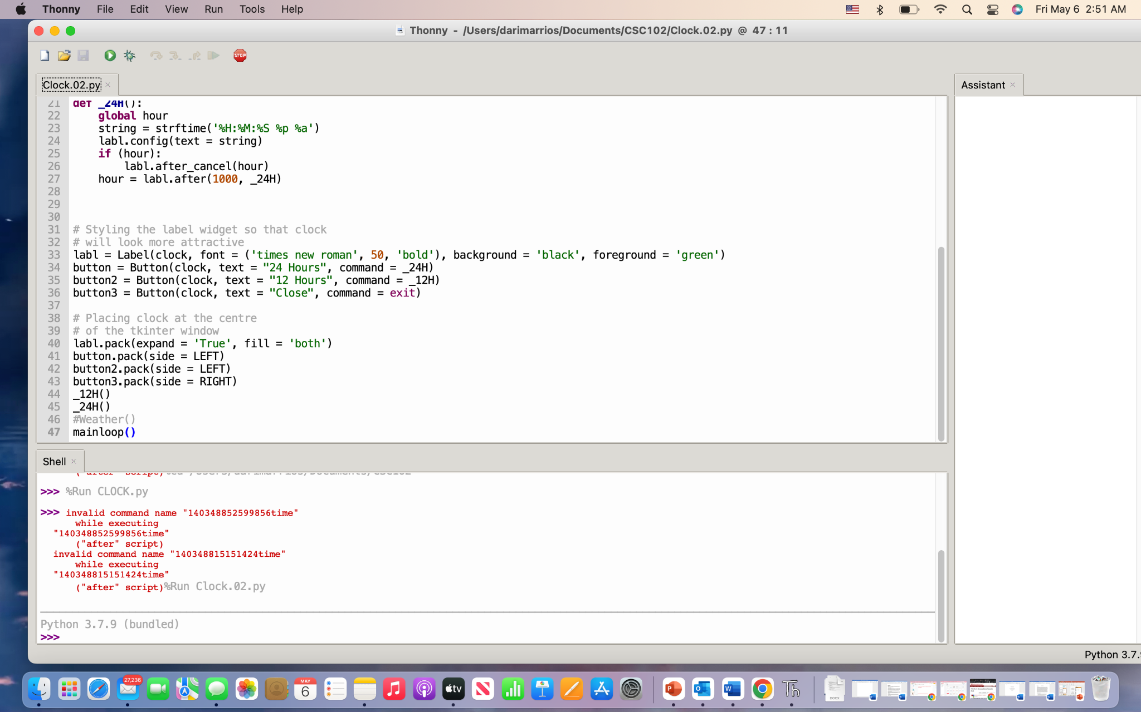
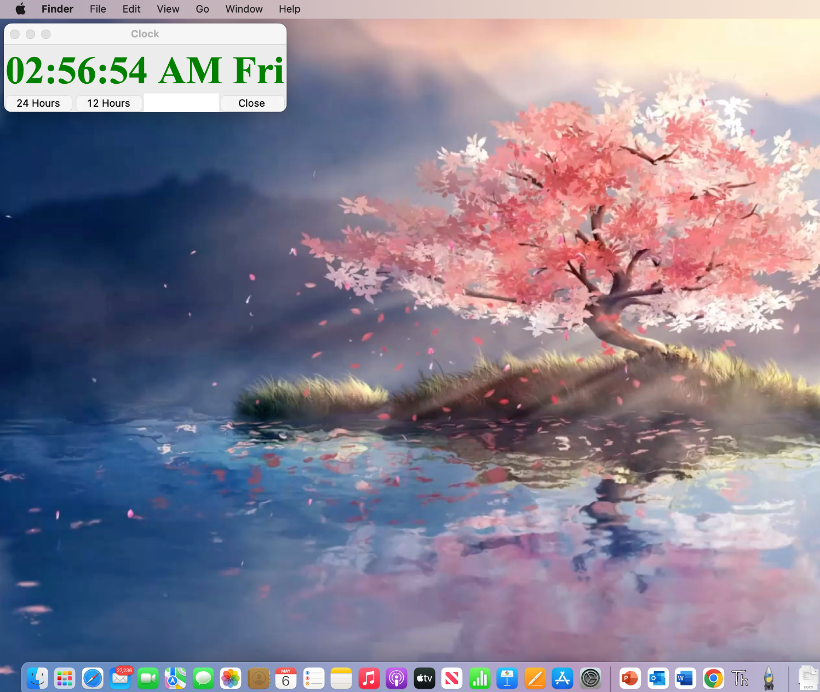
Digital clock

Slide 14
Digital clock
For the digital clock we used the strftime which is a string formatter that takes the time and date of your computer and displays it however you want to.
We wanted for it to have more options, so we created buttons that allowed for the format of the time to change between 12 hours and 24.
This took a long time to figure out since once it was changed the format would loop back to the previous one. Dr.Gourd helped and we added the after_cancel code which stops a function from running after the bottom was clicked for the other one.

Slide 15
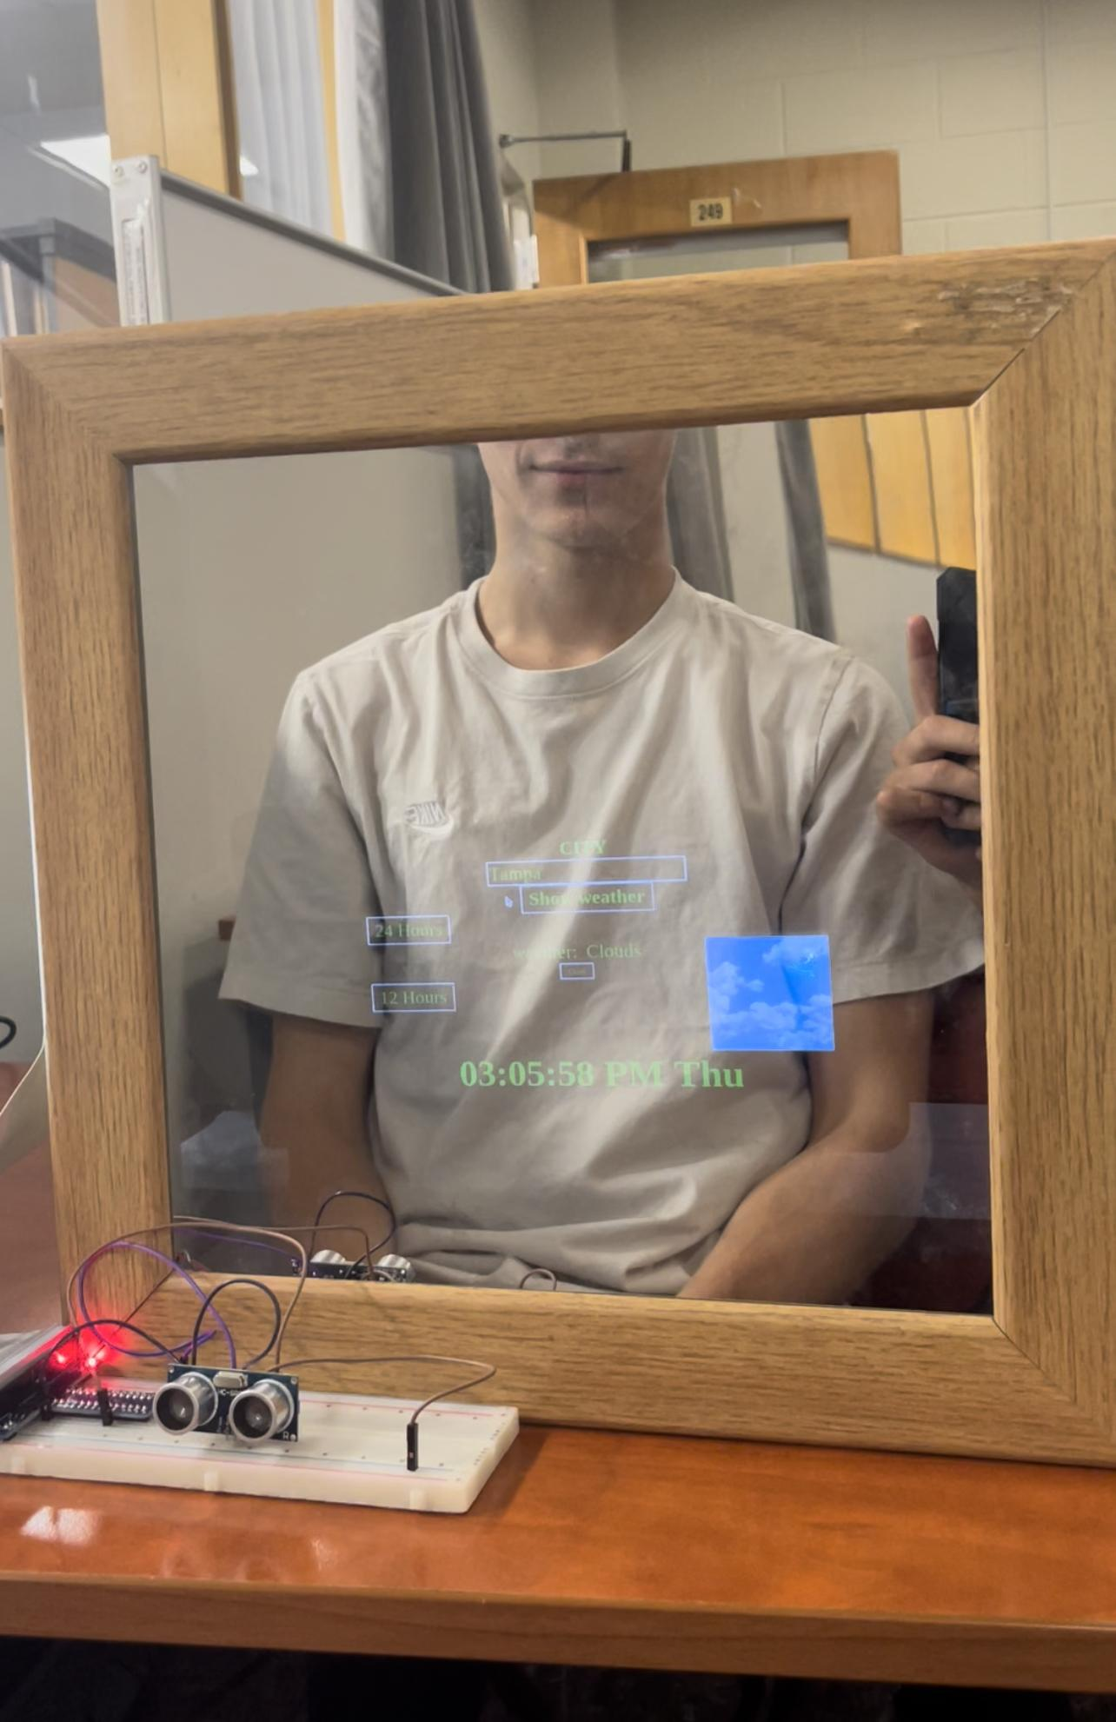
Final product

Slide 16
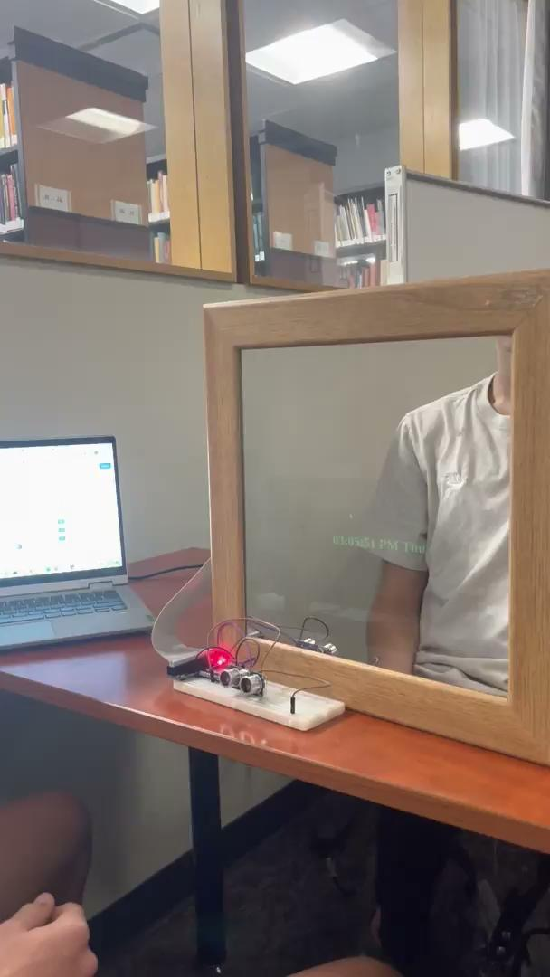
Example video
Showing the ‘motion’ sensor effect as well as switching between 12 and 24 hour time frames
Our weather is invoked
Meaning it will produce the weather of Tampa when turned on.
Weather is able to be produced for other regions

Slide 17
Future Development plans
With more time and money, we would further develop the magic mirror; we could include other features including, connecting and displaying a person’s google calendar with the day’s events, or something similar to that.
We would also make the mirror touch screen, in which when you touch the mirror you could actually change the settings and use it without using the keyboard at all.
We would have the whole screen display as we showed above in goals, and probably add more features to make it user-friendly.

Slide 18
What we learned throughout the process
If you think you can do it then you will be able to do it, we struggled a lot in the codes but eventually we got through everything.
We shouldn’t give up just because it is too hard in the moment because you will always find a way through
Rather than googling everything around, try creating and understanding the logic first, that way you can get through the problem
It is extremely satisfying when you get the end result and seeing the progression since the beginning especially because of all the time and hard work we put into it.

Slide 19
Thank you

